Slide 1
IMDB Movie Review Classification
By
Daniel Timmermann

Slide 2
The Problem:
IMDb wants to add a metric to their website that quickly identifies the ratio of bad to good movie reviews

Slide 3
The Solution:
Build a model that can differentiate between good and bad reviews

Slide 4
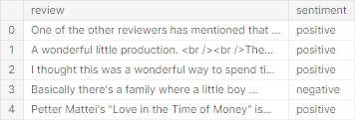
The Data
50,000 reviews
Negative review (4 or less)
Positive review (6 or greater)
Data Source : https://ai.stanford.edu/~amaas/data/sentiment/

Slide 5
Data Wrangling
Expanded Contractions
Special character, accent, and digit removal
Lowercase reviews
Substituted new lines, line breaks, and extra whitespace with a single space

Slide 6
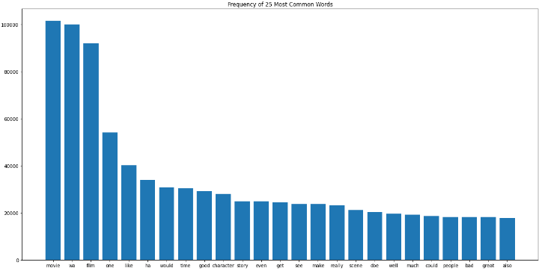
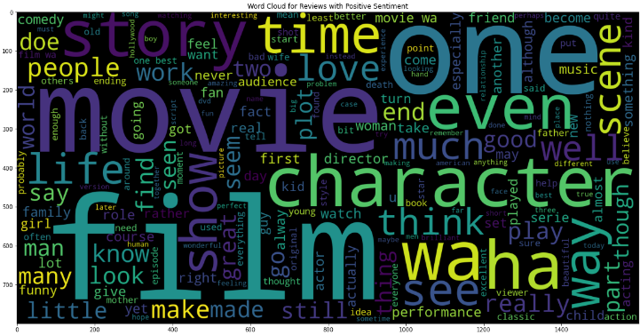
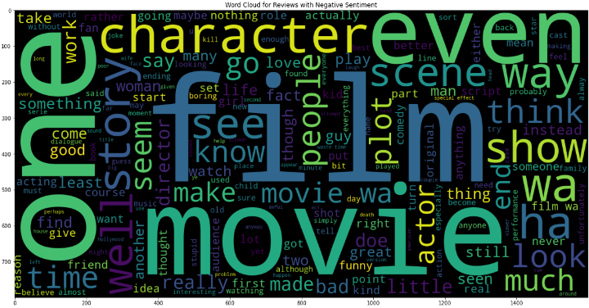
Exploratory Data Analysis

Slide 7
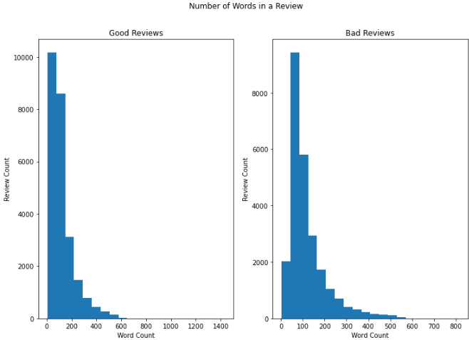
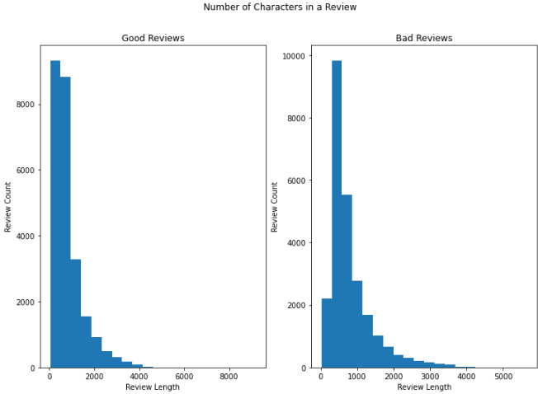
EDA (cont.)

Slide 8
Model Selection
Data Preprocessing
Test size 20%
Lemmatize
Remove stopwords
CountVectorizer (Bag of Words)
Unigrams and bigrams
Logistic Regression
Random Forest
Support Vector Machine

Slide 9
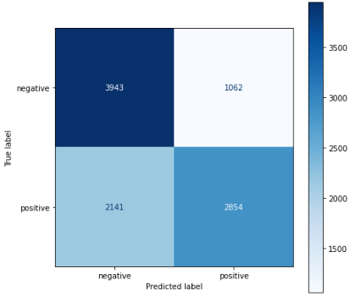
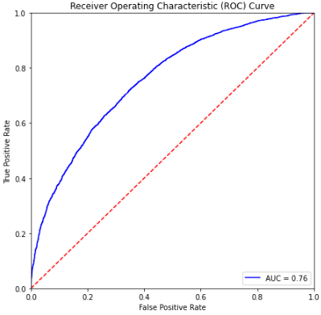
Logistic Regression

Slide 10
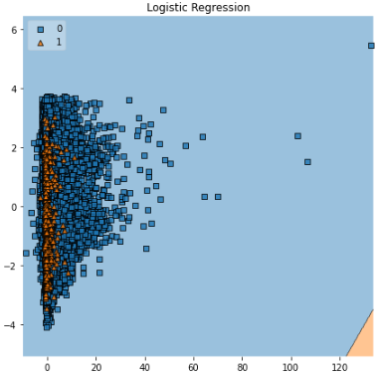
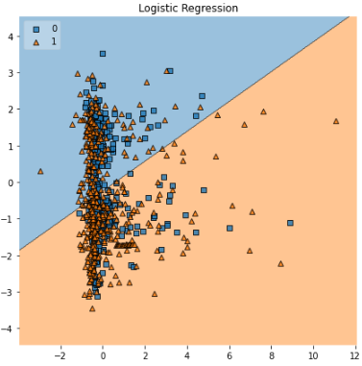
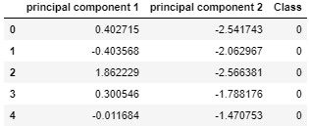
Decision Boundary

Slide 11
Takeaways
Logistic Regression was the best model
Support Vector Machine and Random Forest could perform better with certain parameters, but they also have longer runtime
Different training and testing sets generate different results

Slide 12
Future Research
Use different methods to create features from text
TFidfVectorizer
BERT
Remove the words most frequently found in both negative and positive reviews
Hyperparameter tuning for support vector machine and random forest

Slide 13
Questions?

